Slide 1

ETL COSHAL DATA MANAGEMENT PROJECT
Addressing Dataset Problems Using Excel and SQL
Name: PRIYA SHARMA
Date :

Slide 2
Index
Introduction 3
Dataset Overview 4
Problem Statement 5
ETL Process – Step 1: Data Cleaning 6-7
ETL Process – Step 2: SQL Data Import and Analysis 8-16
Summary of Analysis 17
Challenges Faced 18
Recommendations 19
Conclusion 20
Q&A and Closing 21

Slide 3
Introduction
Project Overview:
This ETL Data Analysis project focuses on analyzing retail data provided by Coshal, a company specializing in art-based products. The primary goal is to derive actionable insights from the data to support strategic decision-making.
Objective:
To clean, process, and analyze company-provided data using Excel and SQL, delivering meaningful insights to enhance operational efficiency and sales performance.

Slide 4
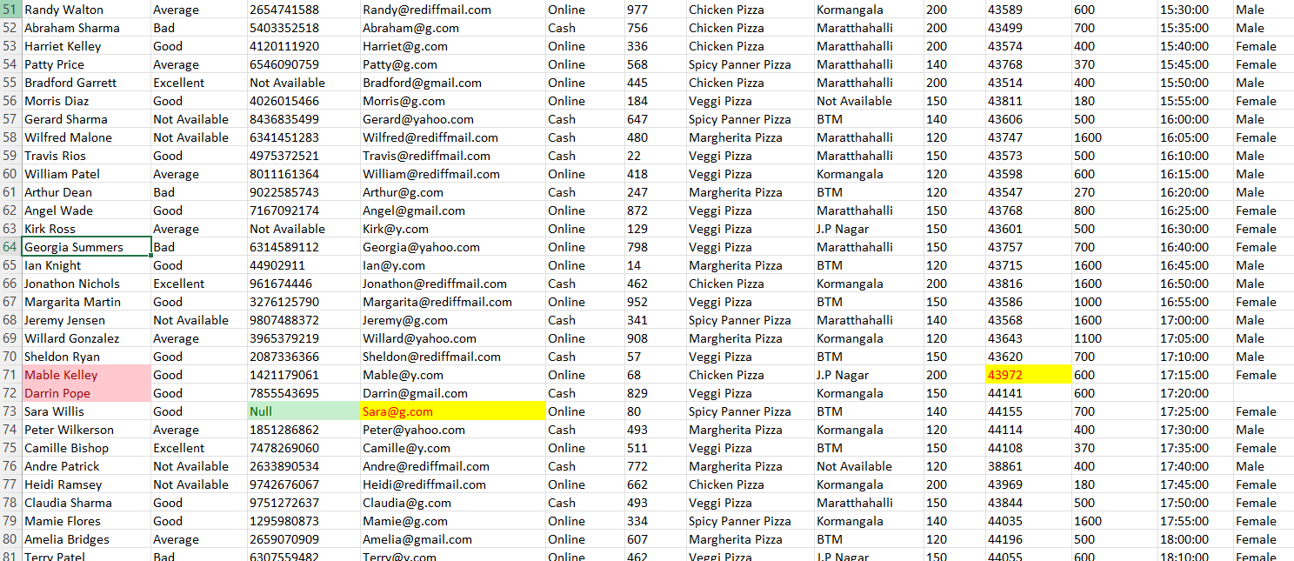
Dataset Overview
Dataset Summary:
Size: 13 columns and 101 rows.
Key Fields: Name, Review, Mobile Number, Email, Money Type, Product ID, Product Type, Location, Price, Date of Order (DOO), Total Amount, Time, and Gender.
Source and Tools Used:
Source: Data was provided via email by Coshal, the retail art product company.
Tools: Excel was used for data cleaning, while SQL was used for detailed data analysis.
Significance of the Dataset:
Enables understanding of customer demographics and purchase behavior.
Facilitates the identification of sales trends and high-performing products.
Provides a foundation for data-driven decision-making to optimize business operations.
Raw data with highlighted issues for reference.

Slide 5
Problem Statement
Coshal, a leading retail art product provider, faced challenges in leveraging data to understand customer preferences, sales trends, and product performance. The dataset provided by Coshal contained issues such as duplicate entries, missing values, and inconsistent formats, which limited the ability to derive meaningful insights.
The primary objectives of this project are to:
Clean and structure the raw data for accurate analysis.
Identify critical sales patterns, customer behavior, and product trends.
Empower Coshal to make data-driven decisions, optimize product offerings, enhance customer satisfaction, and boost overall revenue.
This project aims to transform raw, unstructured data into actionable insights for strategic growth.

Slide 6
Step 1: Data Cleaning
Handling Text and Format Issues
Finding and Addressing Missing/Null Values
Clearing Blank Cells
Correcting Data Types]
Editing Email Domains
Identifying and Removing Duplicates
Identifying and Removing Duplicates
Problem: Duplicate entries distort analysis and reporting.
Solution: Applied Conditional Formatting to highlight duplicates and used the "Remove Duplicates" tool to clean the dataset.
Handling Text and Format Issues
Problem: Inconsistent text formatting (e.g., mixed case, extra spaces).
Solution: Used TRIM, UPPER, and LOWER functions to standardize text data.

Slide 7
Finding and Addressing Missing/Null Values
Problem: Missing or null values hinder accurate data analysis.
Solution: Used Filter to identify and isolate rows with missing or null values, then filled or removed them based on context.
Clearing Blank Cells
Problem: Blank cells cause discrepancies in analysis.
Solution: Used "Find & Replace" or manual deletion to clear blank cells in critical columns.
Correcting Data Types
Problem: Incorrect data types (e.g., text in date columns) disrupt analysis.
Solution: Ensured correct formatting for date and time columns to maintain consistency.
Editing Email Domains
Problem: Inconsistent email domains.
Solution: Used the SUBSTITUTE function to standardize email domains

Slide 8
Step 2: SQL Data Import and Analysis
SQL Process Overview:
The cleaned dataset was imported into SQL to enable efficient querying and analysis.
B. Performed exploratory data analysis :
Analyzed key metrics like sales trends, product performance.
Identified patterns using aggregate functions (SUM, AVG, COUNT).
Filtered specific data using WHERE, GROUP BY, and HAVING clauses.
Ran queries for specific business insights:
Top-selling products.
Seasonal trends in orders.
Customer demographics.

Slide 9
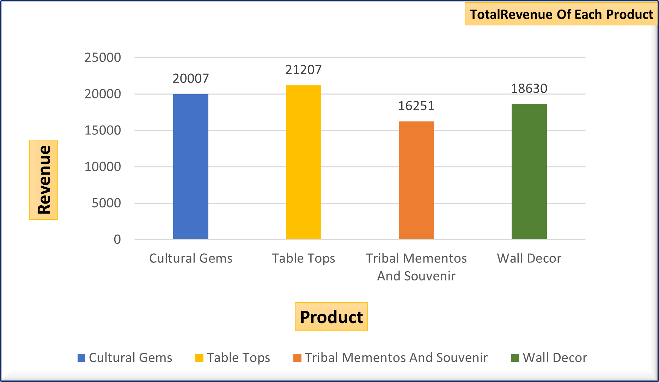
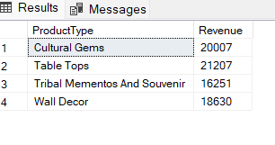
Total Revenue by Product Type
Find the total revenue generated by each product type.
SELECT ProductType, SUM(TotalAmount) AS Revenue
FROM coshal
GROUP BY ProductType;
Output:

Slide 10
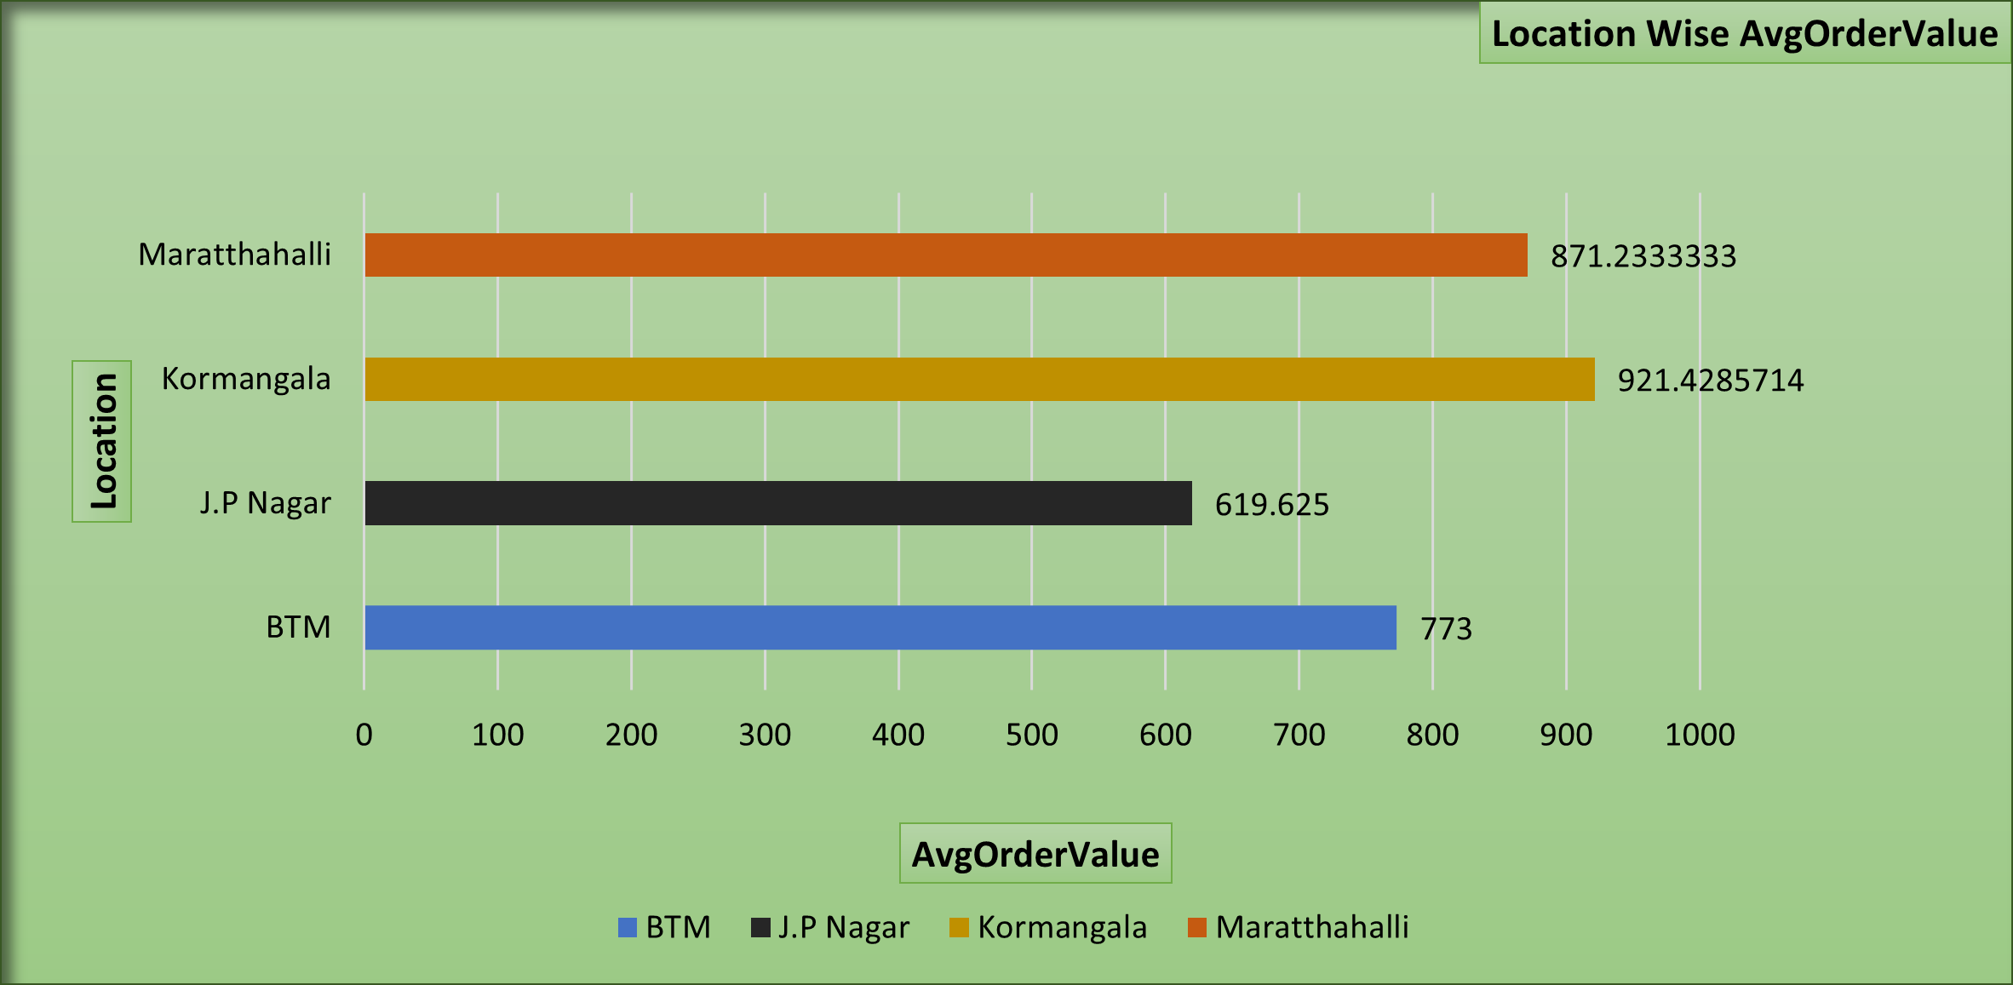
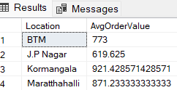
Average Order Value by Location
Determine the average order value by location.
SELECT Location,AVG(TotalAmount) AS AvgOrderValue
FROM coshal
GROUP BY Location;
Output:

Slide 11
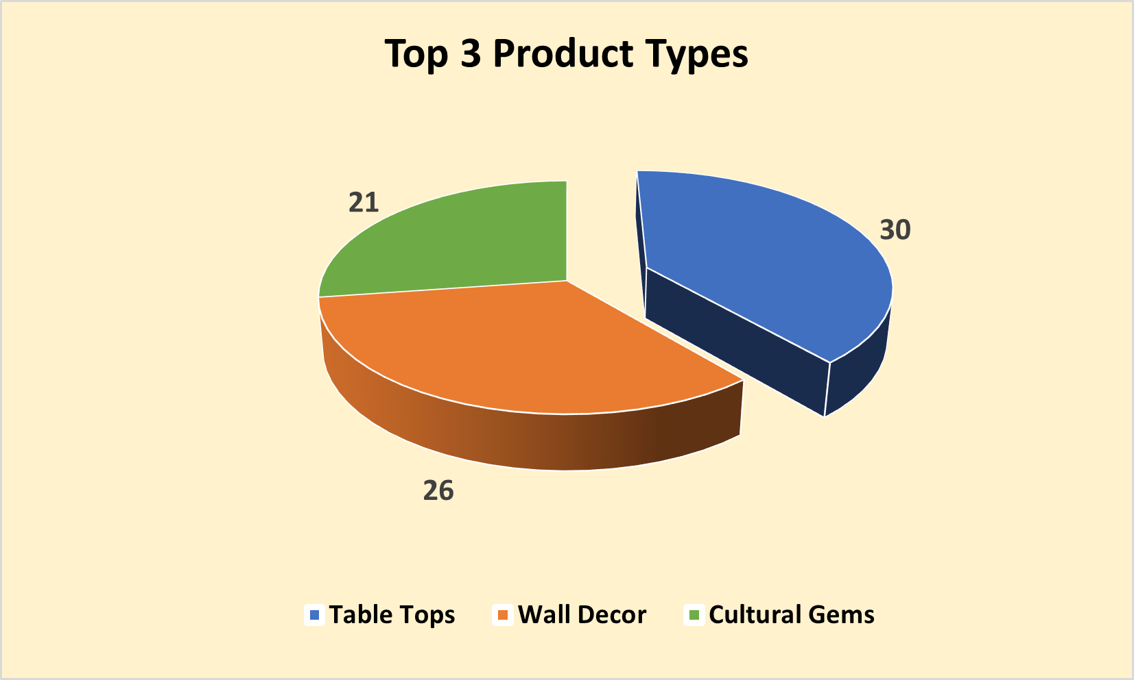
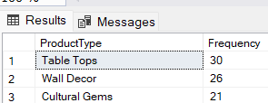
Top 3 Most Frequently Purchased Products
List the top 3 most frequently purchased products.
SELECT ProductType, COUNT(*) AS Frequency
FROM coshal
GROUP BY ProductType
ORDER BY Frequency DESC
Limit 3;
Output:

Slide 12
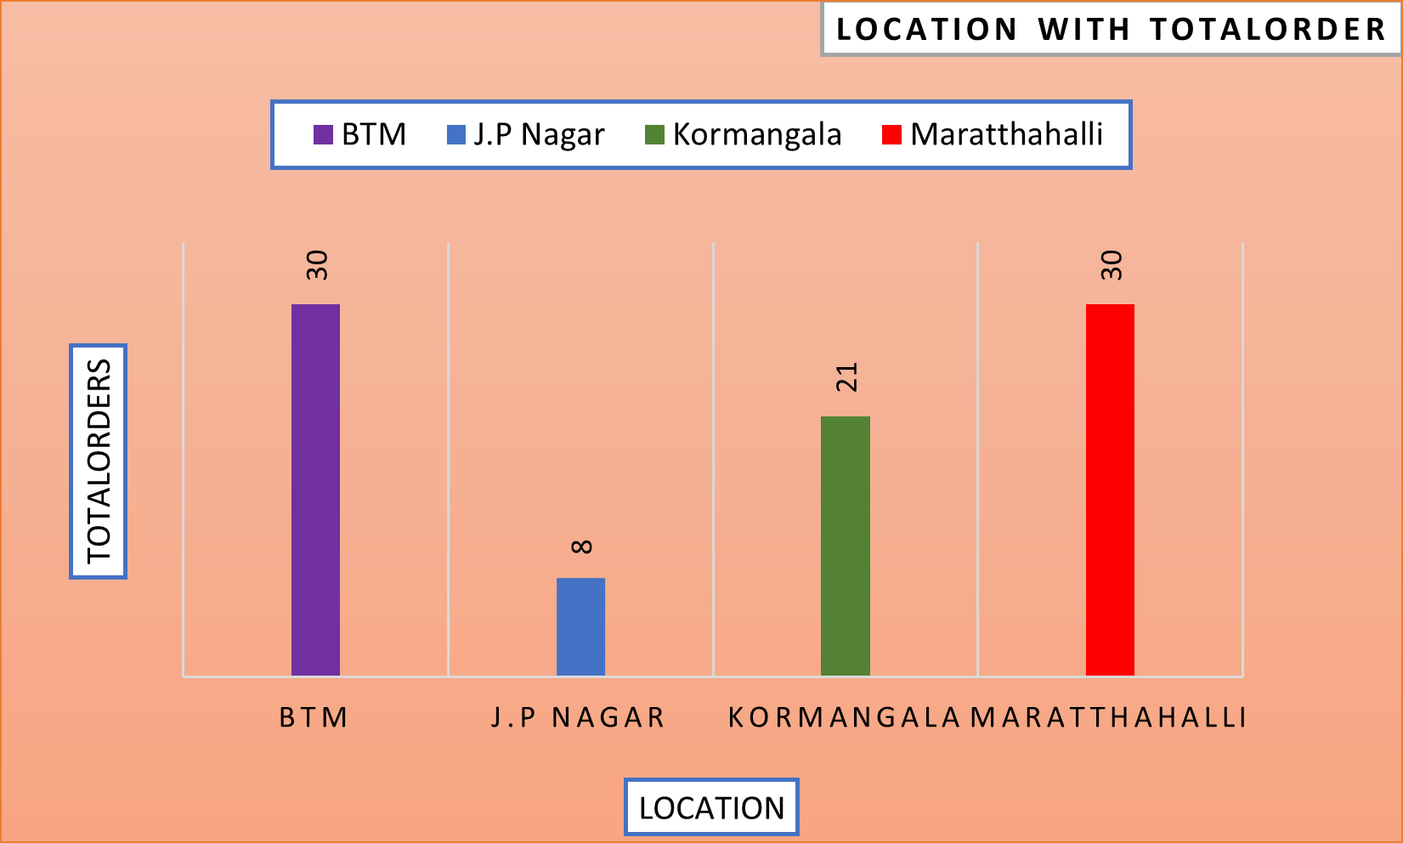
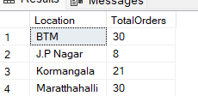
Average Purchase Amount by Product Type
Find the total number of orders placed by customers
in each location.
SELECT Location, COUNT(*) AS TotalOrders
FROM coshal
GROUP BY Location;
Output:

Slide 13
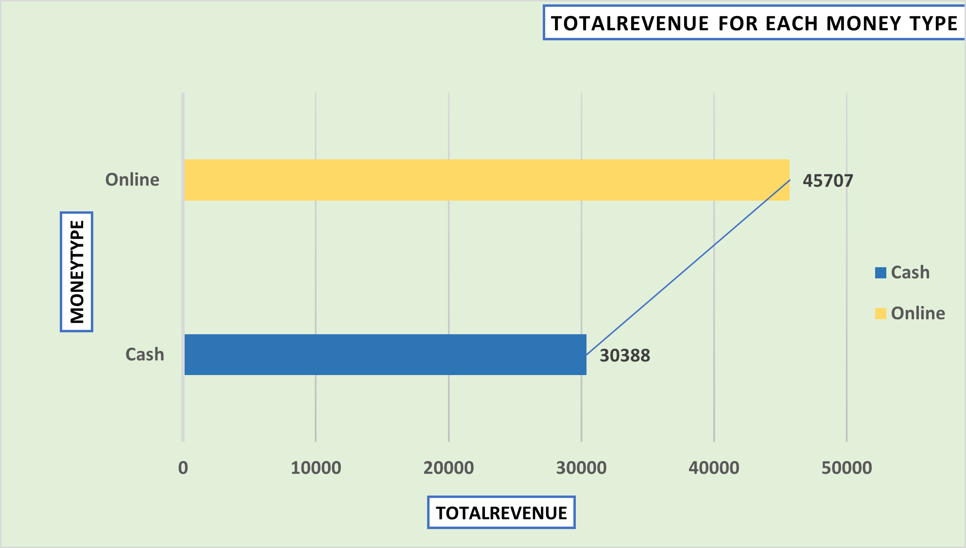
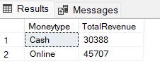
Total Sales Revenue by Money Type
Calculate the total sales revenue for each "Money Type."
SELECT Moneytype,SUM(TotalAmount) AS TotalRevenue
FROM coshal
GROUP BY MoneyType;
Output:

Slide 14
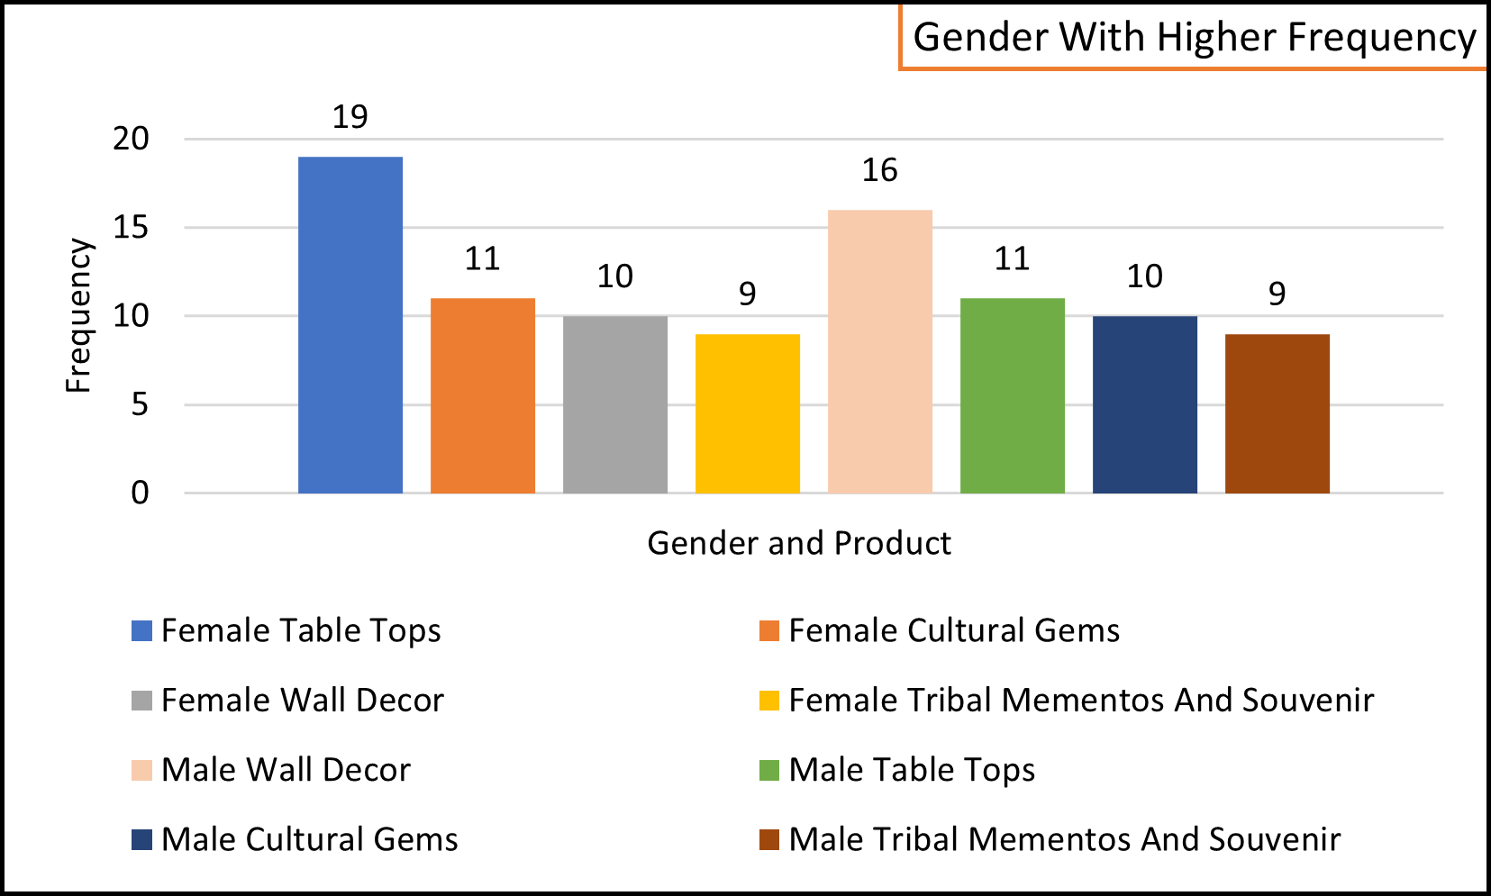
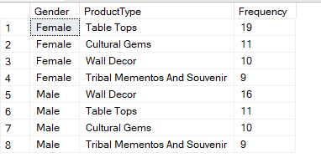
Product Preferences by Gender
Write a query to find the frequency of product purchases by gender,
sorted by gender and frequency in descending order.
SELECT Gender, ProductType, COUNT(*) AS Frequency
FROM coshal
GROUP BY Gender, ProductType
ORDER BY Gender, Frequency DESC;
Output:

Slide 15
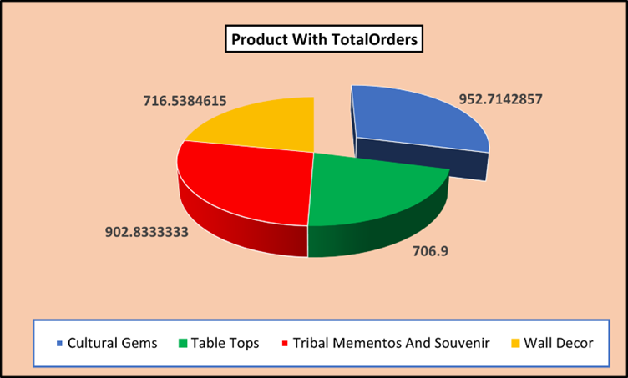
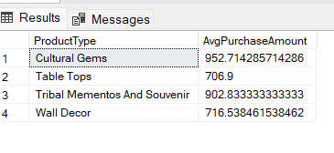
Average Purchase Amount by Product Type
Write a query to calculate the average purchase
amount for each product type.
SELECT ProductType,AVG(TotalAmount) AS AvgPurchaseAmount
FROM coshal
GROUP BY ProductType;
Output:

Slide 16
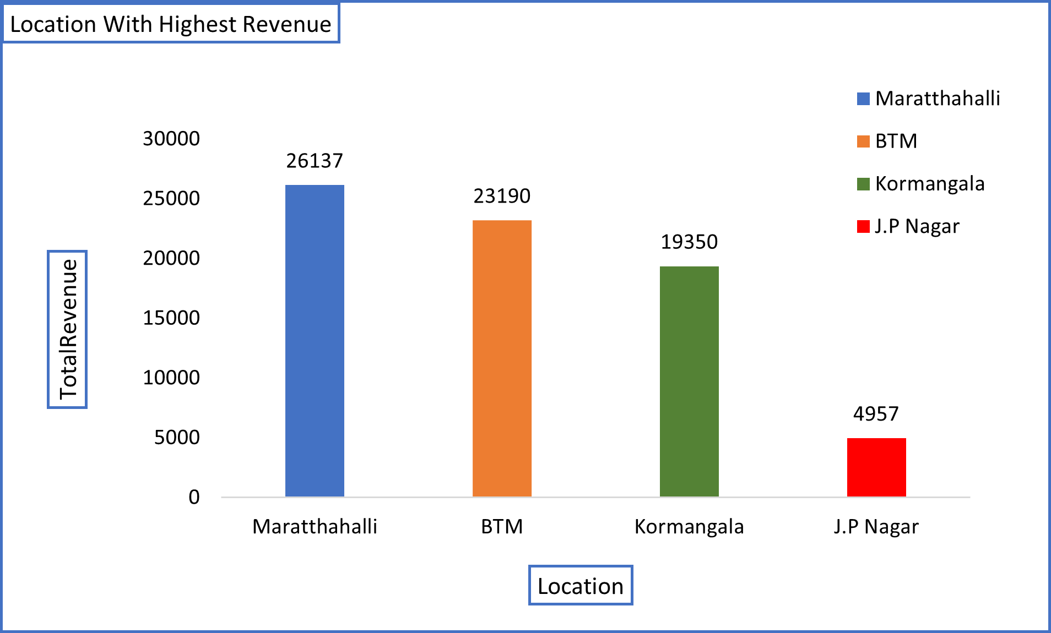
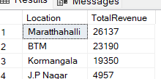
Total Sales Revenue by Location
Identify the location with the highest revenue generation.
SELECT Location, SUM(TotalAmount) AS TotalRevenue
FROM coshal
GROUP BY Location
ORDER BY TotalRevenue DESC
LIMIT 1;
Output:

Slide 17
Summary of Analysis
Total Revenue by Product Type: Table tops are the highest-selling product.
Average Order Value by Location: Koramangala has the highest average order value.
Top 3 Most Frequently Purchased Products:
(1)Table Top
(2)Wall Décor
(3)Cultural Gems
Average Purchase Amount by Location:
(1)BTM
(2)Marathahalli
(3)Koramangala
(4)JP Nagar
Total Sales Revenue by Payment Method:
(1)Cash: ₹30,388
(2)Online: ₹45,707
Total Sales Revenue by Location:
(1)Highest: Marathahalli
(2)Lowest: JP Nagar
.

Slide 18
Challenges Faced
Data Challenges:
Missing and inconsistent entries in critical fields (e.g., Price, Date).
Duplicate records impacting data accuracy.
Variability in customer information (e.g., Gender, Email domains).
Technical Challenges:
Formatting data to align with SQL schema.
Optimizing SQL queries for effective analysis.
Resolution Strategies:
Systematic data cleaning in Excel to address inconsistencies.
Employing structured SQL queries for efficient data handling.

Slide 19
Strategic Recommendations
(1)Expand Inventory for Table Tops: Increase production and diversify designs to capitalize on the highest-selling product category.
(2)Target Marketing in Koramangala and Marathahalli: Focus marketing efforts and exclusive offers in these locations due to their strong revenue and purchasing power.
(3)Enhance Online Payment Promotions: Offer additional discounts or cashback for online payments to encourage more customers to use digital methods, further boosting revenue.
(4)Revamp Tribal Mementos and Souvenirs: Investigate reasons for low demand and consider redesigning, rebranding, or bundling these products to increase sales.
(5)Gender-Specific Campaigns: Develop targeted advertisements and promotional offers, such as highlighting wall décor for males and table tops for females.
(6)Introduce Cultural Gems Marketing Campaigns: Leverage the high average purchase value of cultural gems by creating premium marketing campaigns and limited-edition collections.
(7)Implement Customer Loyalty Programs: Create loyalty programs, especially in high-performing areas like Koramangala and Marathahalli, to retain top customers.
(8)Optimize Pricing for Low-Performing Products: Reassess the pricing strategy for tribal mementos and souvenirs to make them more competitive and appealing.
(9)Leverage Social Media for Product Promotions: Use social media campaigns to highlight top products like table tops and wall décor, targeting demographics based on product preferences.
(10)Location-Based Events and Pop-Ups: Organize pop-up stores or events in high-revenue areas like Marathahalli to attract more foot traffic and create brand buzz.

Slide 20
Conclusion
The ETL data analysis project successfully transformed raw data into actionable insights for Coshal, a retail art product-based company.
Data cleaning resolved inconsistencies, enabling reliable analysis.
SQL queries uncovered key trends in customer behavior, product performance, and sales distribution.

Slide 21
Thank You

